Slide 1
Custom Connectors Masterclass 🧙

Slide 2
Sponsor side of Diamond Sponsor, Bouvet. Platinum Sponsor LINK Mobility.

Slide 3
Sponsor slide of Gold, Silver and Bronze Sponsors.

Slide 4

Daniel Laskewitz
Cloud Advocate, Microsoft
Big football fan (Ajax Amsterdam)
Daniel.Laskewitz@microsoft.com
https://www.linkedin.com/in/laskewitz
https://www.twitter.com/laskewitz
https://aka.ms/laskewitz

Slide 5

Mats Necker
CTO knk Group, MVP
Medium Football Fan (Hamburg SV)
mats@nckr.de
linkedin.com/in/matsnecker/
x.com/matzzt
nckr.de

Slide 6
Introductions
What’s your name?
What’s your role?
What is your experience with connectors?

Slide 7
Agenda
1️⃣ Introduction to Custom Connectors 2️⃣ Building a Custom Connector from Scratch 3️⃣ Testing and Troubleshooting a Custom Connector 4️⃣ Top tips and tricks for Custom Connectors

Slide 8
Timetable
09:00 – 10:15 – Introduction + Section 01
10:15 – 10:30 – Coffee Break
10:30 – 11:30 – Section 02
11:30 – 12:15 – Lunch
12:15 – 13:00 – Section 03
13:00 – 14:30 – Section 04
14:30 – 14:45 – Coffee Break
14:45 – 16:00 – Q & A / Open forum

Slide 9
Logistics
4 sessions – every session has presentation + lab + discussion + q&a
You will get an account from us
Bathrooms
Refreshments
Lunch – 11:30 – 30 minutes lunch
WiFi – Microsoft Guest Event Code msftevent100DM

Slide 10
Introduction to Custom Connectors

Slide 11
Agenda
Connectors
What is a connector?
Custom connectors
What & why of custom connectors?
How to learn more about custom connectors
Lab – Get started with custom connectors

Slide 12
Connectors

Slide 13
What is a connector?
A formal definition of a REST API
Allows the REST API to talk to Microsoft Power Apps, Power Automate, Copilot Studio, and Logic Apps
Currently 1200+ connectors in the product
API Properties
OpenAPI
Definition
Binary
Connector

Slide 14
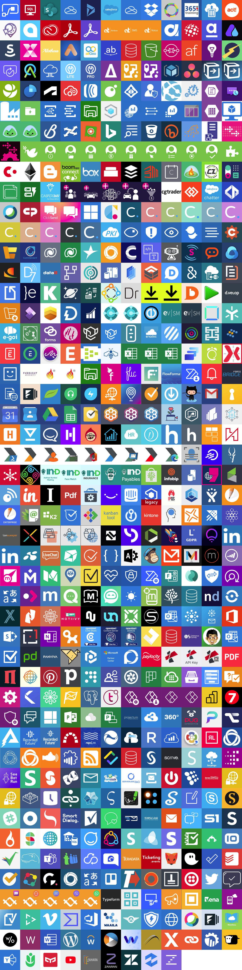
1000
1200+ Connectors

Slide 15
Custom Connectors

Slide 16
Why Custom Connectors?
Add services that are not currently supported
Expand connectors that currently don't have the trigger/action you want
Custom connectors are simple to build, don't require a lot of coding
Can be built using the wizard, a postman collection, or with your favourite IDE (for instance VS Code)
Can be shared, packaged and certified via GitHub

Slide 17














Custom connector types
Connector
Type
Custom Connector
Certified Connector
Independent Publisher Connector
API
Availability
Public or private
Public
Public
Service
Owner
Connector developer or someone else
Connector developer
Someone else
Audience
Internal
Everyone
Everyone

Slide 18
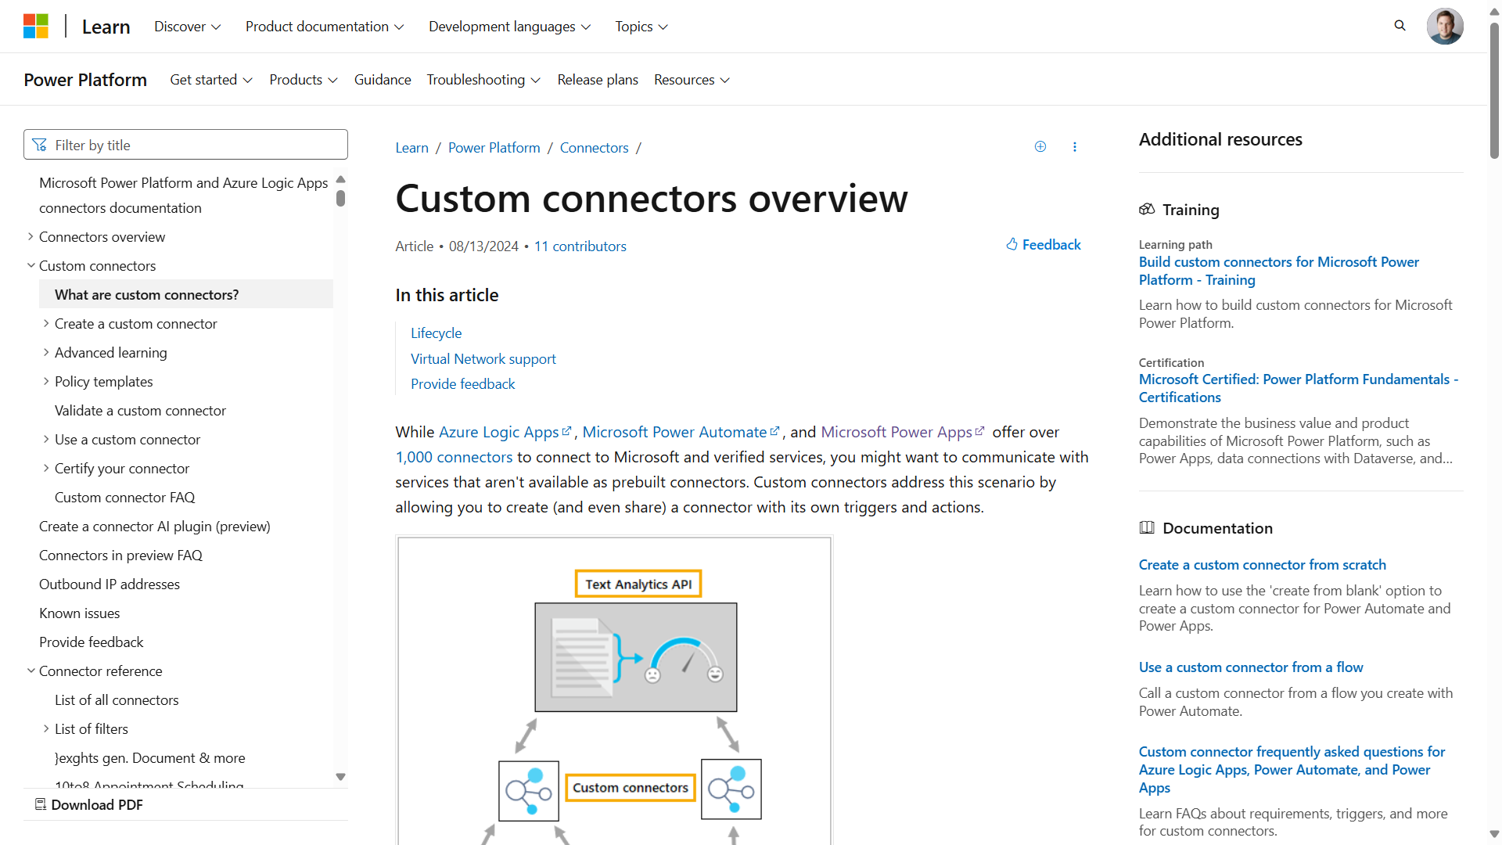
Custom Connector Resources: Microsoft Learn
https://aka.ms/cc/learn

Slide 19
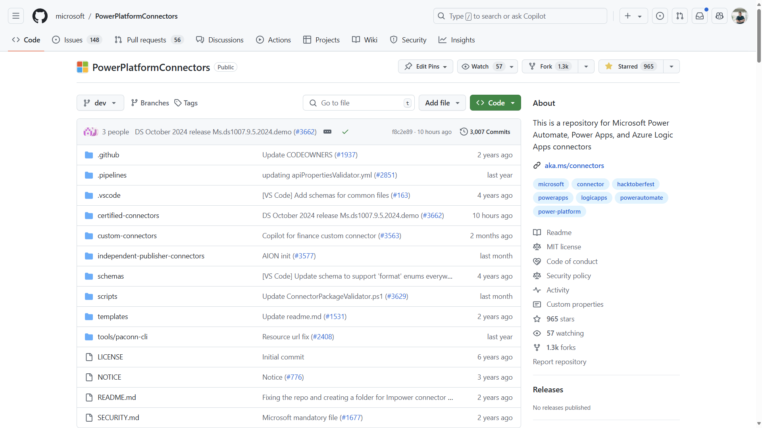
Custom Connector Resources: GitHub
https://aka.ms/cc/github

Slide 20

DEMO TIME!

Slide 21
Lab 01: Getting Started

Slide 22
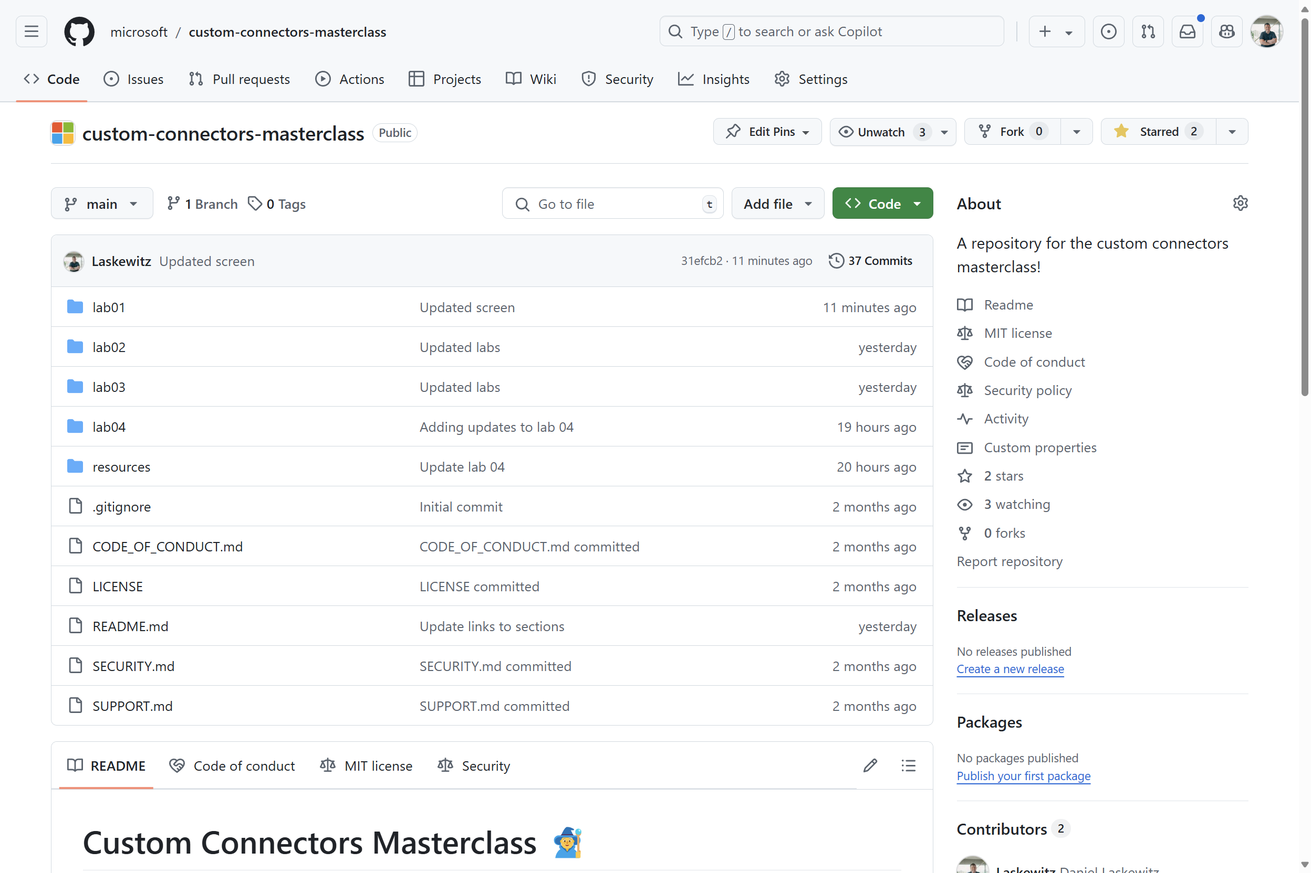
Lab environment
https://aka.ms/custom-connector-masterclass

Slide 23
Lab 01 – Getting Started
Creating a new browser profile
Logging into the account you are going to use during the workshop
Creating a developer environment
Installing Visual Studio Code
Installing the Power Platform Tools extension
Connecting to the Power Platform environment
Import your first connector

Slide 24
Lab 01 – Wrap up
Questions?
Ideas?
Comments?

